Slide 1
Code Slayer
Tic Tac Toe Game
By Elvis, Akshay, Luis, Stephanie, Nick
Notes:
1
1

Slide 2
Role of each member
Elvis Jimenez | Team lead, developer and architect of the GUI interface.
Akshay Patel | Sub team lead and architect of the single player mode (PvP).
Luis Oropeza | Tester and secretary
Stephanie Reyes | Secretary and Tester.
Nick | Architect of the AI.
Notes:
2
2

Slide 3
Product Requirements
Goals of actor | Play Tic Tac Toe
Tasks | Game launches. User can sign in, register, or play as guest. User can select single player or multiplayer. User selects difficulty level. User can view game history. User can exit game.
Preconditions | Empty 5x5 grid
Exceptions | If a game is in progress and user want to start a new game a pop up message will show up to confirm a start of a new game. Which will be consider a lost for current player.
System alternatives | At any point user is able to change from single mode to multiplayer mode and chose from any of the difficulty levels.

Slide 4
Objectives
Develop testing strategies
Conduct testing plans with documentation logs
Deliver a product to client that meets requirements and remains within projected costs.
Submit functional product and documentation by deadline

Slide 5
Domain Knowledge
Glossary
Term | Definition
5x5 Tic Tac Toe | A game can be played with two players using X and O signs. The player who succeeds in placing four of their marks in a horizontal, vertical, or diagonal row wins the game.
GUI(Graphical User Interface) | Two people can operate it using keyboard and mouse
Platform | OS based on the which software the game is running
SDL | Extensive library for C++
Visual Studio | Integrated development environment for implementing the code
One Player | A player play against the computer
Multi Player | More than one player can play with each other.
Difficulty Level | In one player, player can play it in easy, medium and hard levels.

Slide 6
Acronym | Meaning
AI | Artificial Intelligence
GUI | Graphical User Interphase
PvP | Player versus Player
PvE | Player versus Environment or Computer
TTT | Tic Tac Toe

Slide 7
Modification History
Modification History since last presentation to client on 11/1/16:
Modified UML Class Diagram
Included hard difficulty level
Functional player registration
Included player score history
Testing Plan Documentation
Expanded detailed steps on requirements
Elaborated scenario descriptions
Reevaluated COCOMO model for resource allocation

Slide 8
Milestones
9/9/16 | The product design layout has been developed
9/16/16 | The product design layout has been improved with features.
9/23/16 | The coding has begun and a 5X5 board has been created
9/30/16 | The product has the single or multiplayer feature
10/3/16 | Product is able to play Human VS Human
10/19/16 | Product has an easy, medium, and hard feature.
10/24/16 | AI has initialized
11/1/16 | AI is complete
11/15/16 | Main menu has been started
11/21/16 | Main menu completed and started to user login

Slide 9
Risk Management
Risk Management Activity | Comments
Time constraints risk | If a member start to fall being the team lead have to pick up the slack to make up the time.
Data loss risk | All team members have a back of the data for this project. GitHub has a version of our data as well.
Members leaving risk | If a team member leave the roles will need to be divided among the rest of the team members.
Equipment malfunction risk | All members have a computer or a way to get a computer to perform project presentation needed.
Not enough logged of the codding | Any and all team members who have the knowledge of C++, would instruct the team member/s in question.
Poor communication risk | The group has set up a slack, group me, and email to pass along any message.

Slide 10
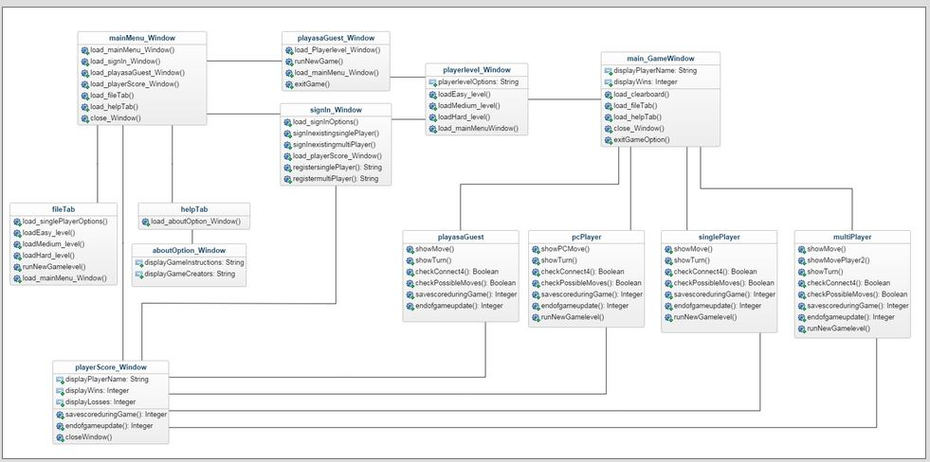
Class Diagram

Slide 11
Use Case 1
Goals of actor | User registers to play game or play as a guest
Task | Initially register a user name to start playing the game
Preconditions | No user name is registered
Exceptions | Error message is shown if name is already registered
Variation of action interactions | User can choose to create a user name or play as a guest
System change/production | Guest will be deleted once game is closed

Slide 12
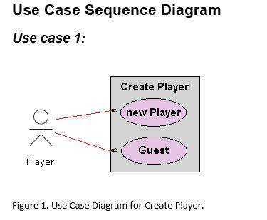
Use Case: 1 Create player or guest for Tic Tac Toe game

Slide 13
Continue…
General Description
This enables for user to create a new player or sign in as a guest.
Use Case 1: Creating a player
Brief Description Allows a new player to sign in with player name.
Step-by-Step Description Player inputs name and signs in. Player will be allow to see the record of wins and losses.

Slide 14
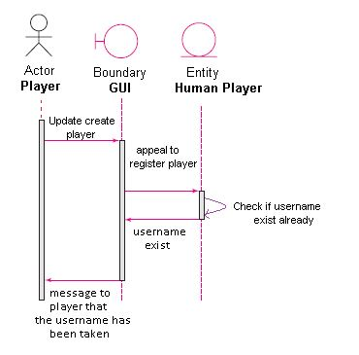
Continue…
Sequence Diagram

Slide 15
Continue…
Use case 1: Player name already exist (anomaly 1)
Brief Description Player username already exist.
Step-by-Step Description Player uses name that already exist Player will get a message that informs player that the username is already taken.

Slide 16
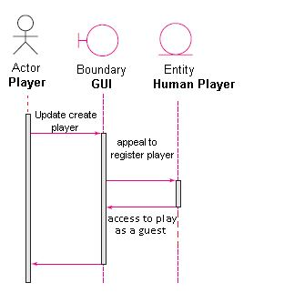
Continue…
Sequence Diagram

Slide 17
Continue…
Use case1: Player plays as a guest. (Anomaly 2)
Brief Description Player plays as a guest.
Step-by-Step Description Player does not need a username and plays as a guest. Guest player will not create a report of wins and losses.

Slide 18
Use Case 2
Goals of actor | User chooses to display game history
Task | Display all user scores that have played the Tic-Tac-Toe
Preconditions | Any game in progress is temporarily blocked and only the score can be seen
Exceptions | Current game play is covered and not able to move until score page is closed
Variation of action interactions | User able to display score any time during the game
System change/production | Score can only be view not modified.

Slide 19
Use Case 3
Goals of actor | Multi-Player selection
Task | User selects to play multi-player mode
Preconditions | Only to be used in the software while playing against another Human.
Exceptions | Multi-Player Mode is only used against human vs human
Variation of action interactions | User choose who want to go first or randomized who’s player one or two. Users have to enter there own stones
System change/production | User name may change according to player.

Slide 20
Use Case 4
Goals of actor | Single player selection
Task | Game Play is to play against AI when bored. User will have to create an account or plays as a guest. User has to chose difficulty in level as well
Preconditions | Only to be used in the software while playing against AI.
Exceptions | Only one player can play at a time against the AI.
Variation of action interactions | User will be able to chose difficulty level and to choose to play as a guest, create a user name, or logging as an existing user.
System change/production | Depending on level the game becomes challenging.

Slide 21
Use Case 5
Goals of actor | Selecting difficulty level
Task | To assign a certain level of difficulty before a new game starts.
Preconditions | Player has to choose a skill level of either easy, medium or hard in order to start playing the game.
Exceptions | Can only be used against the AI
Variation of action interactions | AI acts differently according to level selected
System change/production | AI algorithm change according to level selected.

Slide 22
Use Case 6
Goals of actor | End of Game Play
Task | Exits the game being played, or Play a new game , being multiplayer or single mode
Preconditions | The game play has to have finished either with a winner or a draw giving the user/s an option to start a new game or end the game
Exceptions | Confirmation of quitting game at any time is needed. Keeping in mind if current game has not reach an end the user who had the last turn will be consider the loser
Variation of action interactions | User/s can quit or start a new game at any time but have to confirm action
System change/production | If chosen to quit everything will close. If action is taken in the middle there will be consequences.

Slide 23
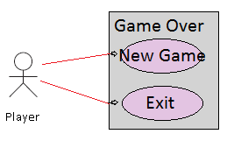
Continue…
Use Case Diagram for Game Over

Slide 24
Continue…
General Description
This enables for user to start a new game or exit the game.
Use Case: Starting new game
Brief Description Allows a player to start a new game.
Step-by-Step Description Player clicks new game. Player will start a new game.

Slide 25
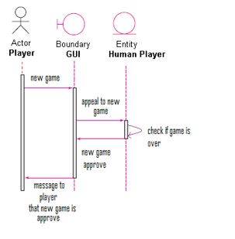
Continue…
Sequence Diagram

Slide 26
Continue…
Use case: Player chooses new game (anomaly 1)
Brief Description Player chooses new game.
Step-by-Step Description Player chooses to start a new game. Player will get a message that informs player that new game has begun.

Slide 27
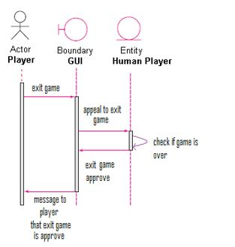
Continue…
Sequence Diagram

Slide 28
Continue…
Use case: Player chooses to exit game. (Anomaly 2)
Brief Description Player exits game.
Step-by-Step Description Player does not want to start a new game and exits game. Player will not start a new game and the game will close down.

Slide 29
Non-Functional Requirements
Cost Constraints:
The project has a budget of $0.00. No further maintenance costs will be required in the future.
Reliability:
The software has a shelf life of 2 years after its final release. Updates will provided until its requirement
Time Constraints:
The time constraints are finding time to accommodate everyone’s availability to meet. Also, we need to organize adequate allotted time to completing the project. The software will be available by December 2016.

Slide 30
Testing Plan
Objectives of execution-based testing:
Test prototype for reliability and performance
Testing the integration of embedded systems in the prototype
The embedded features among the following systems will be tested:
Sign In
Register Player
Difficulty level selection
Single Player New Game
Multiplayer New Game
Player Scores
Exit Game

Slide 31
Testing Cases
Testing Case 1: Game launches and main menu is displayed
Testing Case 2: AI responds to player move in single player mode or guest playing mode
Testing Case 3: Moves reflect on grid and shows turn of next player in every game mode
Testing Case 4: AI displays winner when 4 connected is reached
Testing Case 5: Every level increases in difficulty
Testing Case 6: Scoreboard database functions to store name and scores
Testing Case 7: Player is able to quit game during a running game match

Slide 32
Testing Risk Management Plan
The team lead and secretary will be testing the implementation of the algorithm.
SQA will be testing source code functionality.
Length: 3 weeks
Team Composition Testing Requirements:
Personal Computer
Visual Studio 2015
Github
Emails
Weekly Meetings

Slide 33
Types of Testing
System Testing
Interface Testing
Black Box Testing
Regression Testing
Component Testing

Slide 34
System Testing
TEST STRATEGY FOR LOGIN AND SIGN-UP
This module will be tested against all test cases .
Input: valid username, invalid username, repeated usernames, unique usernames.
TEST STRATEGY FOR SINGLE-PLAYER MODE
The efficiency of AI to predict correct moves will be tested.
Inputs: three stones in a row, four stones in a row, empty rows, five stones in a row, one stone in a row, two stones in a row
TEST STRATEGY FOR MULTI-PLAYER MODE
Inputs: Player inputs empty name, Player plays as a guest, player is a registered user, player goes first, player goes second.
TEST STRATEGY FOR LEVEL DIFFICULTY
Inputs: difficulty level easy, difficulty level medium, difficulty level hard
TEST STRATEGY FOR UPDATE/RETREIVE SCORES
The reliability of the database will be tested.
Inputs: Push invalid data to database, push valid data, retrieve history for invalid users, retrieve history for valid users.

Slide 35
Interface Testing
Interface Testing: Testing all window panels for reliability
Main Menu Window: Gives player options
About Window: display the instructions and game creators
Sign in Window: uses player credentials to play and save score
Register Window: registers player name
Score Window: displays history
Difficulty level Window: player selects level
Game Window: display the initial grid of size 5X5
Exit: the game will be closed.

Slide 36
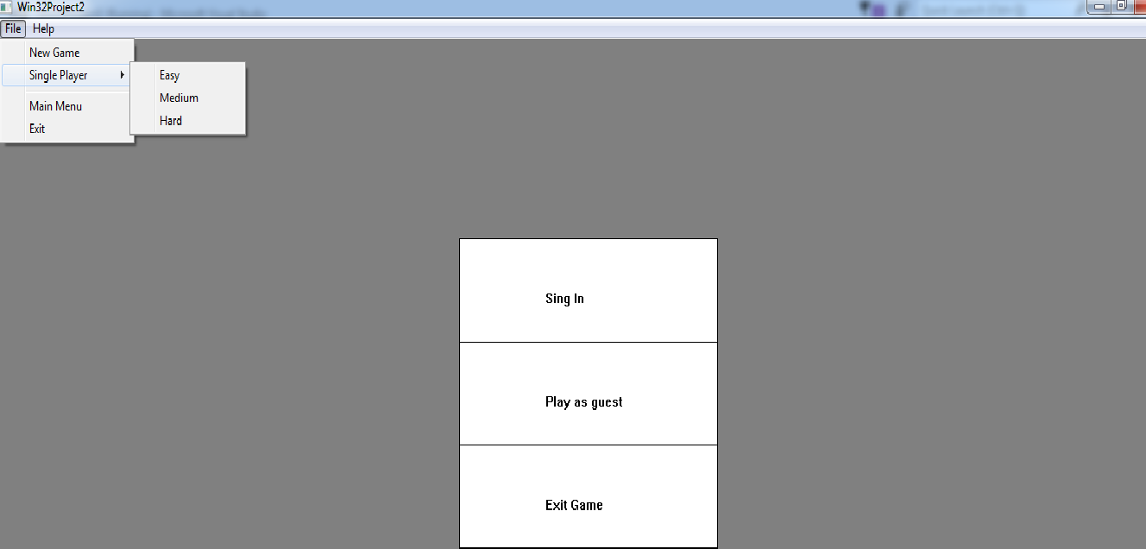
Main Menu Window

Slide 37
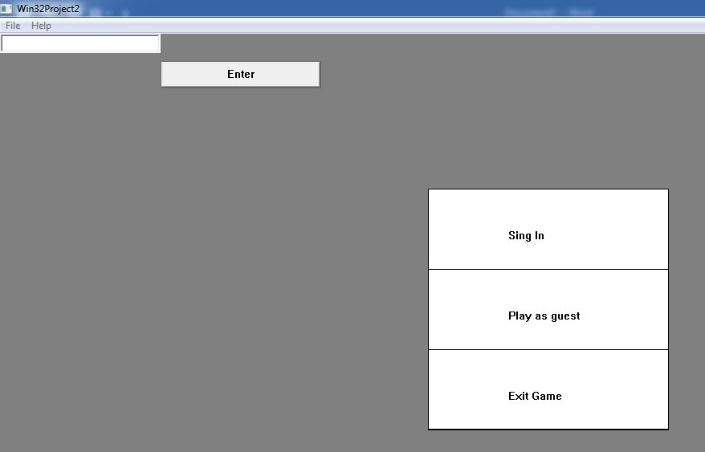
Continue…

Slide 38
Black Box Testing
Black Box testing: Testing the integration of methods for functionality
Sign in: uses player enters credentials to play and save score
Register: registers player name .
Play as a guest new game: begins new game without credentials
Multiplayer new game: begins game for two players
Single player new game: begins game for single player with AI
Difficulty level: player selects level
Score: displays history
Save Score: updates score when 4 are connected
File tab: user options
Help tab: gives about option for instruction display
Exit: the game will be closed.

Slide 39
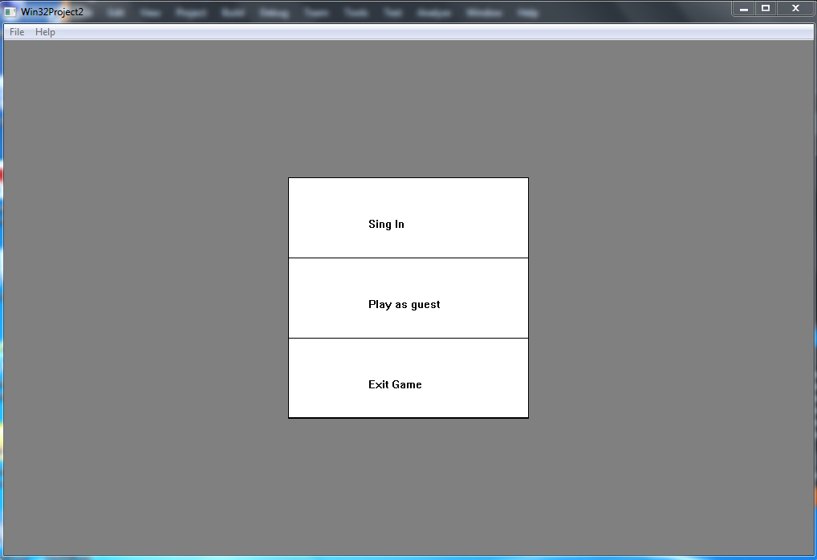
Menu Integration

Slide 40
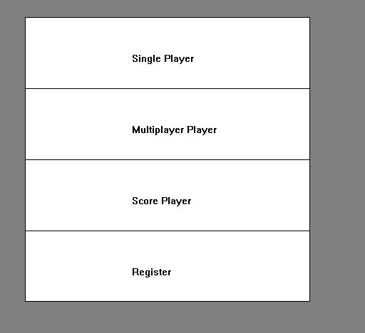
User Options Integration

Slide 41
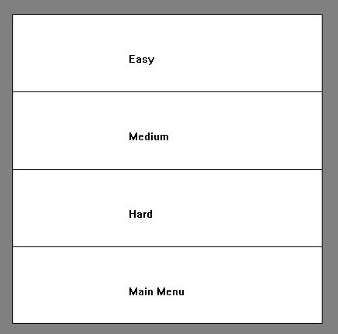
Player Difficulty Level Integration

Slide 42
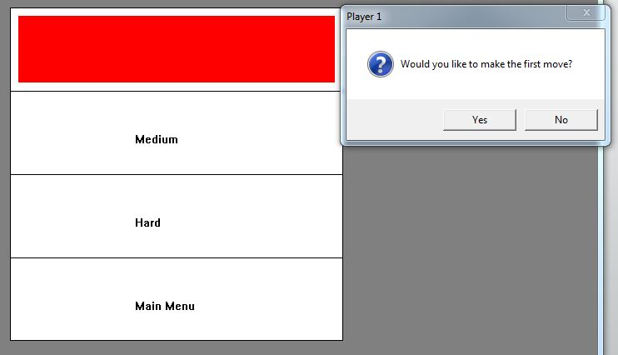
Testing User Interaction

Slide 43
Regression Testing
Regression testing: Testing modified implementation to make sure the program still works with the new changes.
Test fixed bugs promptly.
Write a regression test for each bug fixed.
Identify tests that the program consistently passes and archive them.
Make changes (small and large) to data and find any resulting corruption.

Slide 44
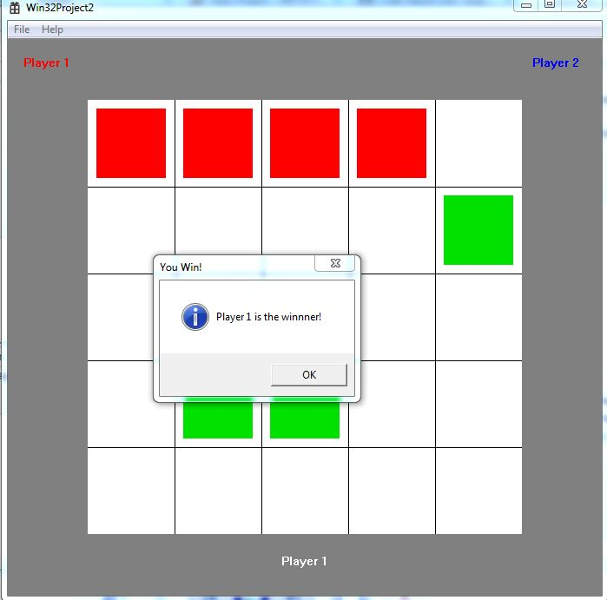
Game Window Functionality

Slide 45
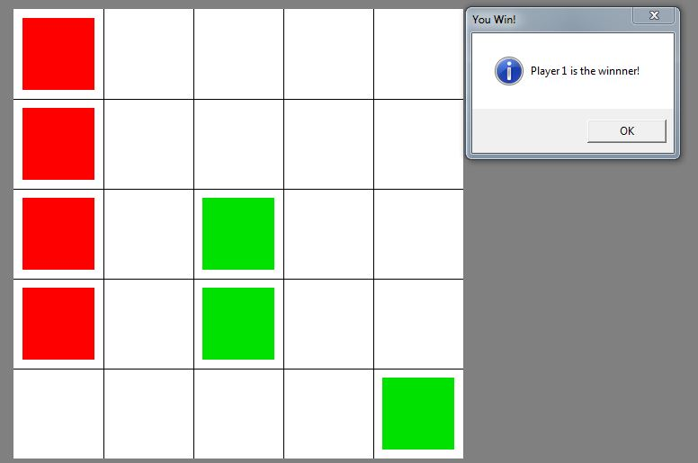
Continue…
After playing with AI in easy mode

Slide 46
Component Testing
Windows Operating System: Win XP /vista/7/8.0 or higher
Software: Visual Studio 2015
Software Testing Techniques:
Statement testing
Block testing
Hardware: Processor : Intel® Core™ i5-4700MQ CPU @ 2.00 GHZ. RAM: 1.00 GB or Higher
System Type: 32- bit or higher Operating System , x86-based processor or higher.
Notes:
Statement Testing: Testing to satisfy the criterion that each statement in a program is executed at least once during program testing
Block Testing: testing to satisfy how many blocks have executed

Slide 47
Criteria
Passing Criteria: Every primary use case must be successful for the application to pass. If any test associated with a primary use case fails, the system test fails.
Suspension Criteria: Tests will be sequenced to exercise progressively more of the system. Testing will be suspended when program faults prevent the tester from moving further into the system.
Resumption Criteria: After analyzing the source of errors and corrected fixes have been carried out; testing will be resumed.

Slide 48
Testing Records
Date | Tester | Action | Feedback
10/1/16 | Elvis | Tested playing mode | Multiplayer mode is not functional
10/4/16 | Elvis | Tested multiplayer mode | All modes are functional
10/20/16 | Nick | Tested game difficulty | Hard level needs improvement
10/25/16 | Luis | Tested AI’s performance | AI’s response is functional
11/2/16 | Axay | Tested AI’s performance | AI’s interface work with user interaction
11/16/16 | Stephanie | Tested main menu functionality | Main menu’s features are not complete
11/22/16 | Nick | Tested user registration | User sign in/registration functions
11/25/16 | Stephanie | Tested score history | Score History needs improvement
11/28/16 | Axay | Tested completion for demo | Product is ready for demonstration
11/29/16 | Luis | Tested completion for demo | Product is ready for demonstration

